Slide 1
Discussion 4: Inheritance
Christine Zhou

Slide 2
Agenda
Announcements
Review: Inheritance
Problem 1
Review: More Inheritance
Problem 2
Review: Static/Dynamic Types
Problem 3

Slide 3
Announcements
Office hours was crowded…
Make sure to get started early and go to office hours earlier for help!
Piazza questions: give us more information!
What is the error that is being outputted? What have you tried to fix the error?
Git-bug
Proj0 due today 11:59 PM
See late policy on the course website
Guerrilla section planned for this weekend
Sunday, 2-5PM in the labs
Midterm next week on Thursday 9/27 7-9PM
https://tinyurl.com/cz-disc4-fa18

Slide 4
Warning
There will be a lot of “Java rules” for the next week or so; bear with us!

Slide 5
Review: Inheritance
public class Fish {
String name;
public Fish(String name) {...}
Public void eat() {...}
public void blink() {...}
}
public class Goldfish {
String name;
public Goldfish(String name) {...}
public void eat() {
print(“bloop”);
...
}
public void blink() {...}
}

Slide 6
Review: Inheritance
extends (can extend only one class)
Inherits all instance variables and methods
Constructor is not inherited, but there will be an implicit call to super( ) in the beginning of the subclass’s constructor (need to make the Fish before making the Goldfish)
constructor() { constructor() {
this.hello = 10; super(); SAME!
} this.hello = 10;
}
constructor() { constructor() {
this.hello = 10; super(10); DIFFERENT!
} this.hello = 10;
}

Slide 7
Review: Inheritance
public class Fish {
String name;
public Fish(String name) {...}
Public void eat() {...}
public void blink() {...}
}
public class Goldfish extends Fish {
public Goldfish(String name) {
super(name); // need to have this!
...
}
public void eat() {
print(“bloop”);
super.eat();
}
}

Slide 8
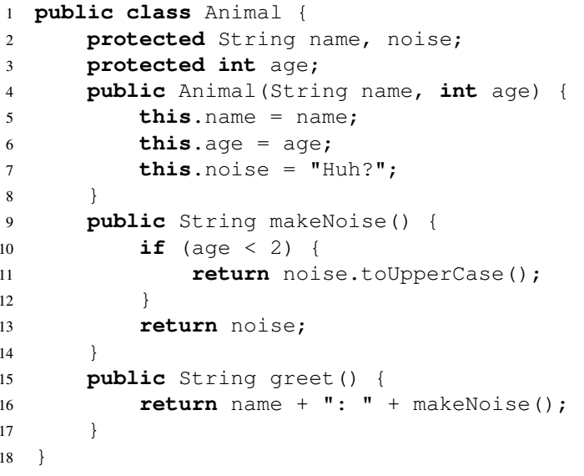
1 Creating Cats
Given the Animal class, fill in the definition of the Cat class so that it makes a "Meow!" noise when greet() is called. Assume this noise is all caps for kittens (less than 2 years old).
How similar are Cats with Animals? How do we take advantage of the extends?
class Cat extends Animal {
}

Slide 9
Review: More Inheritance
Anything that lives in water must have these two methods: float(), swim()
If we have a Fish or SeaOtter class, it must have these!
How do we guarantee this?

Slide 10
Review: More Inheritance
Let’s define an interface, all classes that implement this interface must have all the methods
Can implement multiple interfaces
public interface WaterBeing { public class Fish implements WaterBeing {
public void swim(); public Fish() {...}
public void float(); @Override
} public void swim() {...}
@Override
public void float() {...}
}

Slide 11
Review: More Inheritance
Can also have abstract classes
A normal class with one or more “abstract” things (method/variable)
Any subclass must implement the abstract things, or it will also be an abstract class
Cannot be instantiated (how can you instantiate something when the behavior is abstract?)
public abstract class Fish { public class Goldfish extends Fish {
... ...
public abstract void bloop(); public void bloop() {...}
public void swim() {...} }
}

Slide 12
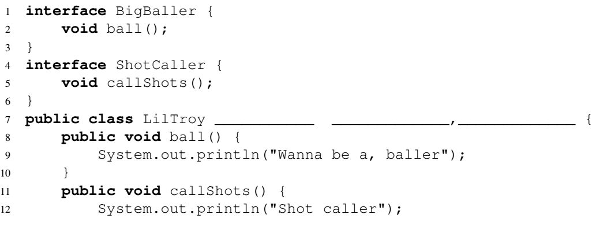
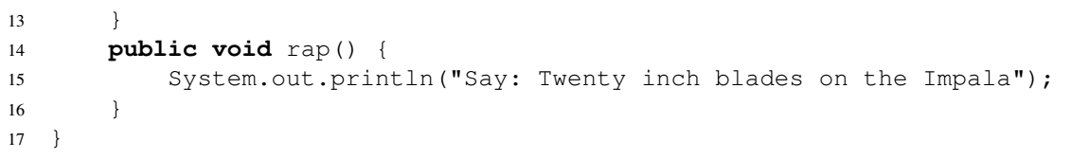
2 Impala-ments
Fill it in so it compiles correctly!

Slide 13
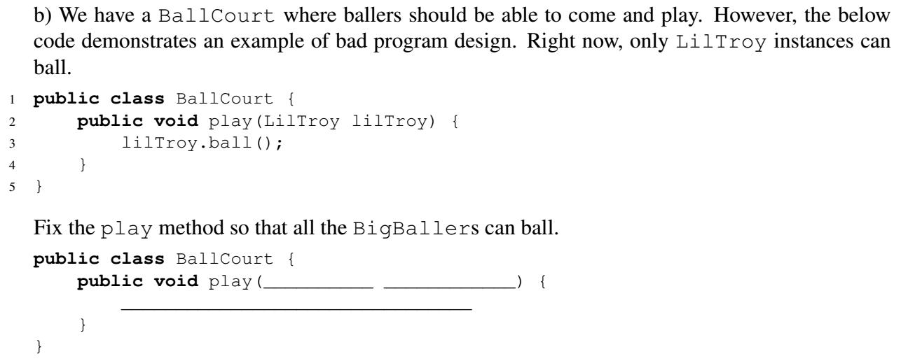
2 Impala-ments

Slide 14
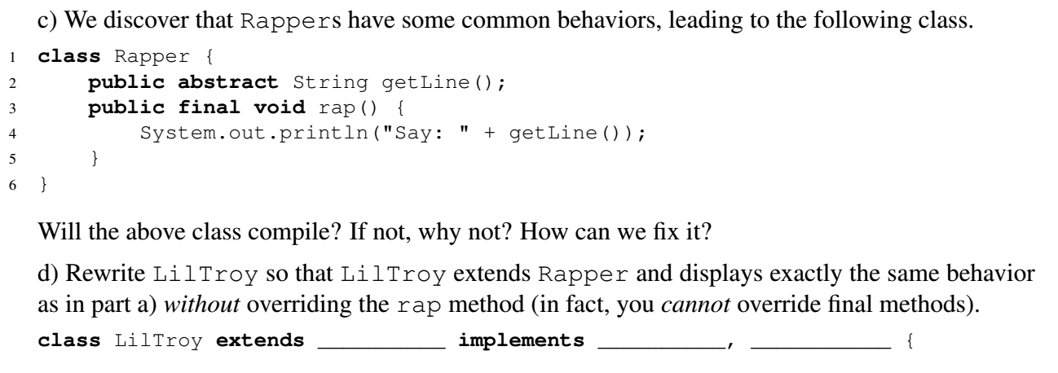
2 Impala-ments

Slide 15
Review: Static vs. Dynamic Types
Fish f = new Goldfish()
Fish is the static type, this is what Java looks at during compilation
Goldfish is the dynamic type, this is what Java looks at during runtime
The dynamic type can be any subclass of the static type
Does Fish b = new Goldfish() work?
How about Goldfish c = new Fish()?
Casting changes the static type of an object temporarily
Fish d = new Goldfish();
((Goldfish) d).bloop(); // static type of d is Goldfish for this line
d.bloop(); // static type of d is Fish

Slide 16
Review: Static vs. Dynamic Types
Method lookup in non-static contexts:
During compilation:
Check if the method exists in the static type
If doesn’t exist, go to the superclass and repeat
If no superclass, compile time error
During runtime:
Run the method in the dynamic type (dynamic method selection), if not in the current class, go to the parent, and then the parent…
Notes:
Static
During compilation:
Will look at the static type to find the method
If can’t find the method, it will look in the parent, and then the parent…
Compile time error if cannot find
During runtime:
Will use the method found during compilation

Slide 17
3 Raining Cats & Dogs
Cat nyan = new Animal(“Nyan Cat”, 5);
Animal a = new Cat(“Olivia Benson”, 3);
a = new Dog(“Fido”, 7);
System.out.println(a.greet());
a.playFetch();
Dog d1 = a;
Dog d2 = (Dog) a;
d2.playFetch();
(Dog) a.playFetch();

Slide 18
3 Raining Cats & Dogs
Animal imposter = new Cat(“Pedro”, 12);
Dog fakeDog = (Dog) imposter;
Cat failImposter = new Cat(“Jimmy”, 21);
Dog failDog = (Dog) failImposter;

Slide 19
3 Raining Cats & Dogs
class Cat extends Animal {
public Cat(String name, int age) {
super(name, age);
this.noise = “Meow!”;
}
public String greet() {
System.out.println(“I am a cat!”);
super.greet();
}
}
What would the following output?
Animal a = new Cat(“Chris”, 4);
a.greet();
Notes:
I am a cat!
Chris: Meow!

Slide 20
Wondering about an edge case involving inheritance or static/dynamic typing? Try it out on your own!
Credit to Michael Ju

